Slide 1
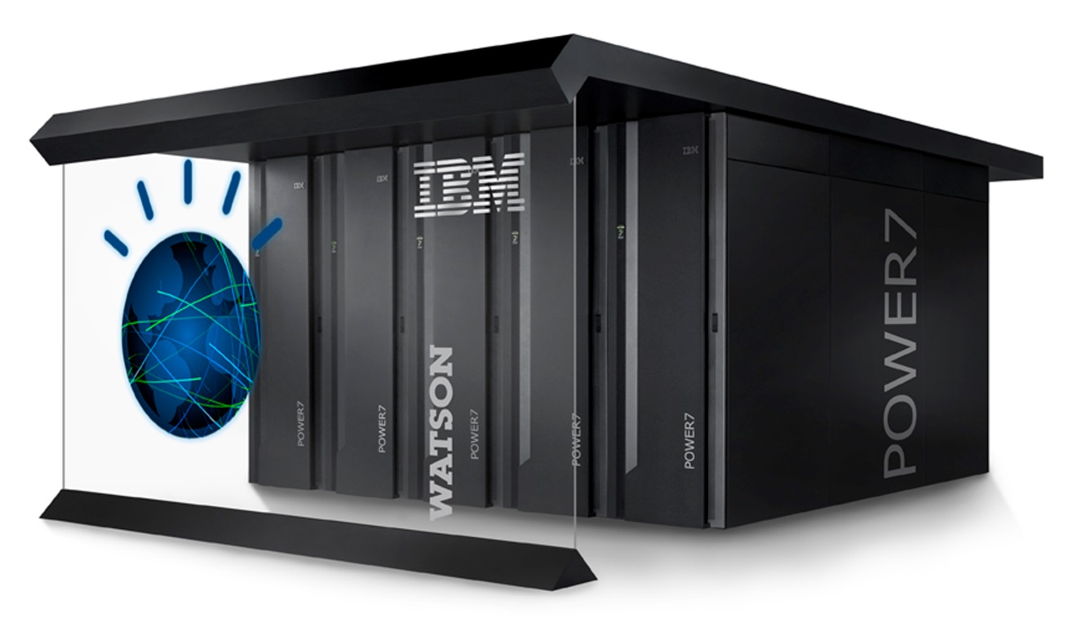
Artificial Intelligence APIs IBM Watson

Slide 2
Artificial Intelligence APIs
AI computation (training, inference,…) carried out in a remote server
AI functionality brought over the web to a client using a RESTful API
For instance how speech input works in android phones
Server usually under the auspices of a company with significant AI expertise
Google, Facebook, IBM, Microsoft, Amazon,…

Slide 3
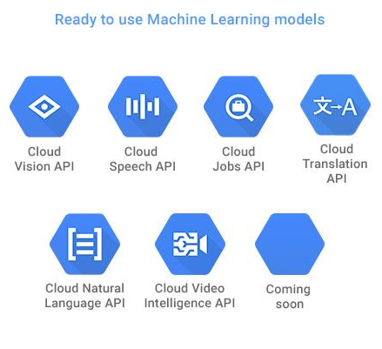
Google cloud AI
Google Cloud's AI provides modern machine learning services, with pre-trained models and a service to generate own tailored models

Slide 4




Google cloud AI
Image Analysis: Google Cloud Vision API enables you to understand the content of an image by encapsulating powerful machine learning models in an easy to use REST API. It quickly classifies images into thousands of categories (e.g. "sailboat", "Eiffel Tower"), detects individual objects and faces within images, and finds and reads printed words contained within images.
Video Analysis: Google Cloud Video Intelligence API makes videos searchable and discoverable by extracting metadata, identifying key nouns, and annotating the content of the video. By calling an easy-to-use REST API, you can now search every moment of every video file in your catalog and find each occurrence of key nouns as well as its significance. Separate signal from noise, by retrieving relevant information by video, shot, or frame.
Speech Recognition: Google Cloud Speech API enables you to convert audio to text by applying neural network models in an easy to use API. The API recognizes over 80 languages and variants, to support your global user base. You can transcribe the text of users dictating to an application’s microphone or enable command-and-control through voice among many other use cases.
Text Analysis: Google Natural Language API reveals the structure and meaning of text by offering powerful machine learning models in an easy to use REST API. You can use it to extract information about people, places, events and much more, mentioned in text documents, news articles or blog posts. You can also use it to understand sentiment about your product on social media or parse intent from customer conversations happening in a call center or a messaging app.
Dynamic Translation: Google Cloud Translation API provides a simple programmatic interface for translating an arbitrary string into any supported language. Translation API is highly responsive, so websites and applications can integrate with Translation API for fast, dynamic translation of source text from the source language to a target language (e.g. French to English).

Slide 5
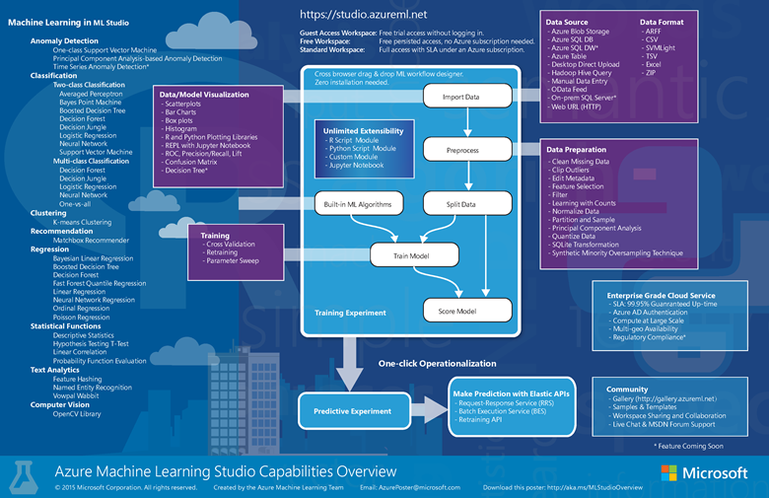
Microsoft Azure ML services

Slide 6

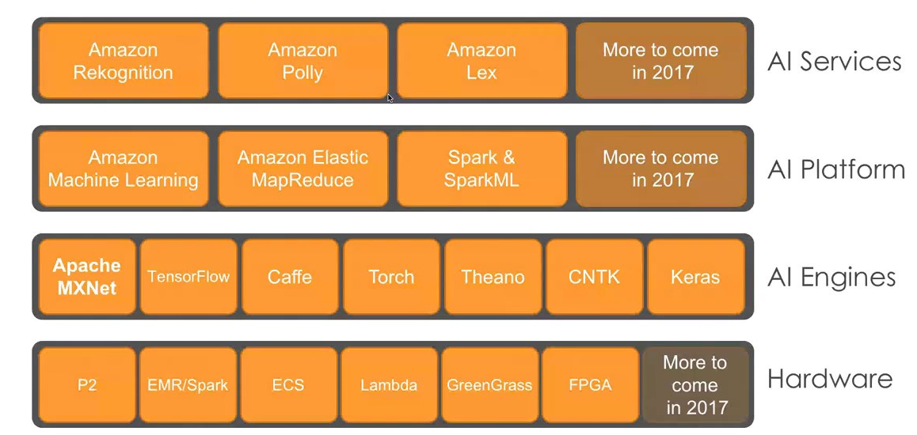
Amazon AWS machine learning

Slide 7
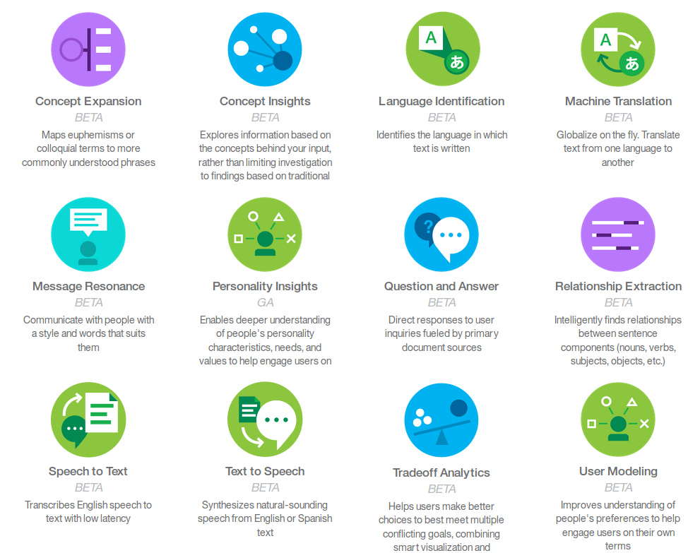
IBM Watson services

Slide 8
What Computers Find Easy (and Hard)
ln((12,546,798 * π) ^ 2) / 34,567.46 =
0.00885
Select Payment where Owner=“David Jones” and Type(Product)=“Laptop”,
Owner | Serial Number
David Jones | 45322190-AK
Invoice # | Vendor | Payment
INV10895 | MyBuy | $104.56
Serial Number | Type | Invoice #
45322190-AK | LapTop | INV10895
David Jones
≠
Dave Jones
David Jones
David Jones

Slide 9
- Computer programs are natively explicit, fast and exacting in their calculation over numbers and symbols….But Natural Language is implicit, highly contextual, ambiguous and often imprecise. - Deep learning has helped push the boundaries of NLP but still…
What Computers Find Easier (and Hard)
Structured
Person | Birth Place
Einstein | ULM
Unstructured
Where was X born?
One day, from among his city views of Ulm, Otto chose a water color to send to Albert Einstein as a remembrance of Einstein´s birthplace.
X is CEO of?
If leadership is an art then surely Jack Welch has proved himself a master painter during his tenure at GE.
Unstructured
Structured
Person | Organization
J. Welch | GE

Slide 10

Watson: state-of-the-art NLP system
Watson is a question answering computer system capable of answering questions posed in natural language
Watson can compete in real-time at the human champion level on the American TV quiz show Jeopardy.

Slide 11
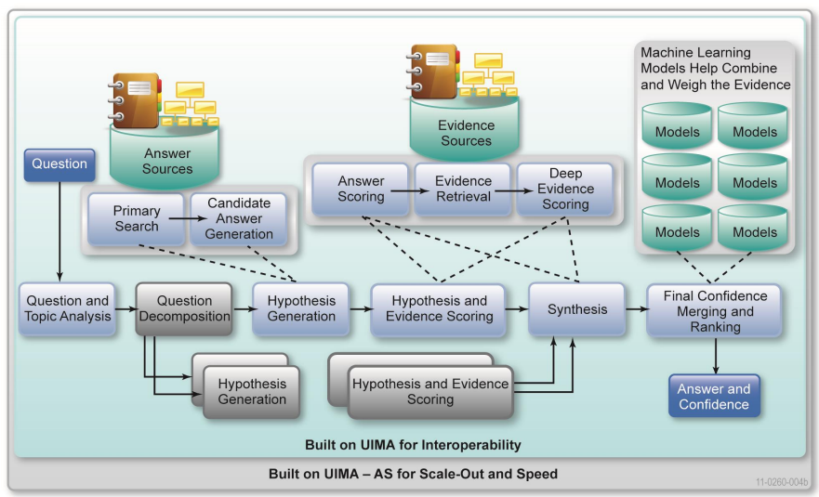
Massively Parallel Probabilistic Evidence-Based Architecture

Slide 12
Training content types
Title oriented documents
Whose title is a concept or named entity
Whose body text discusses the entity
Example: Wikipedia entry
Passage search documents
Journals, magazines, books, web data
Structure document
Database tables
Ontologies

Slide 13
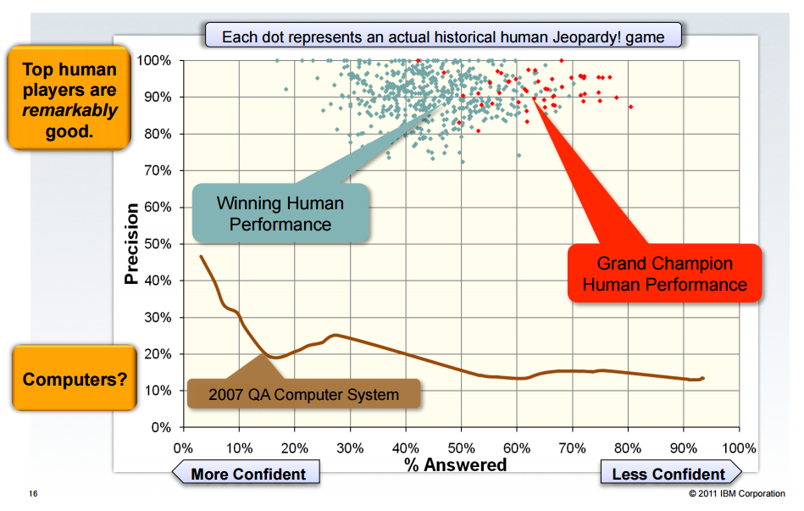
Performance at Jeopardy

Slide 14
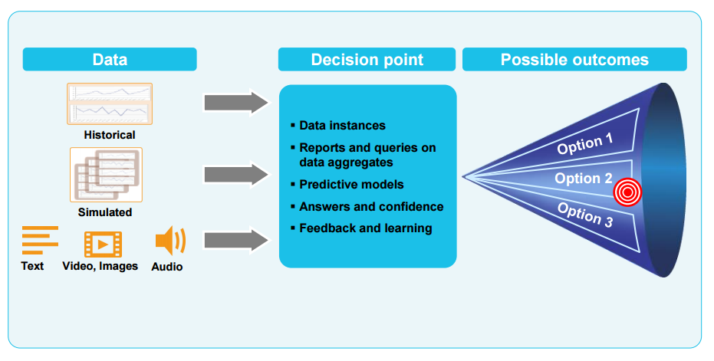
AI powered Decision support systems

Slide 15
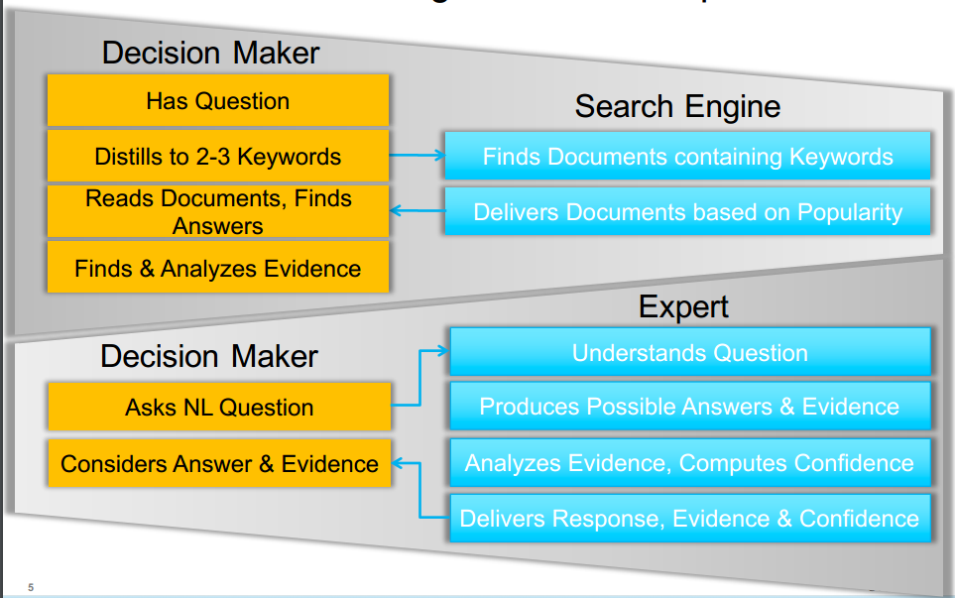
Informed Decision Making: Search vs. Expert

Slide 16
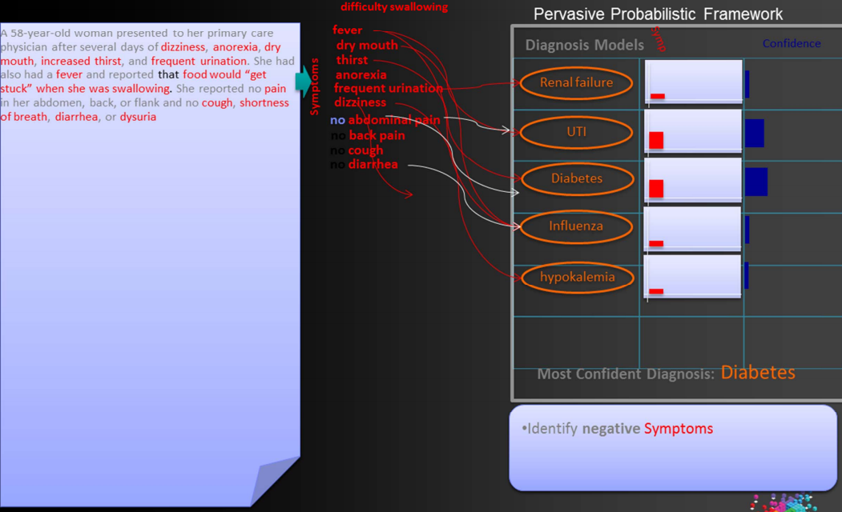
AI powered artificial Doctor: the dream…

Slide 17
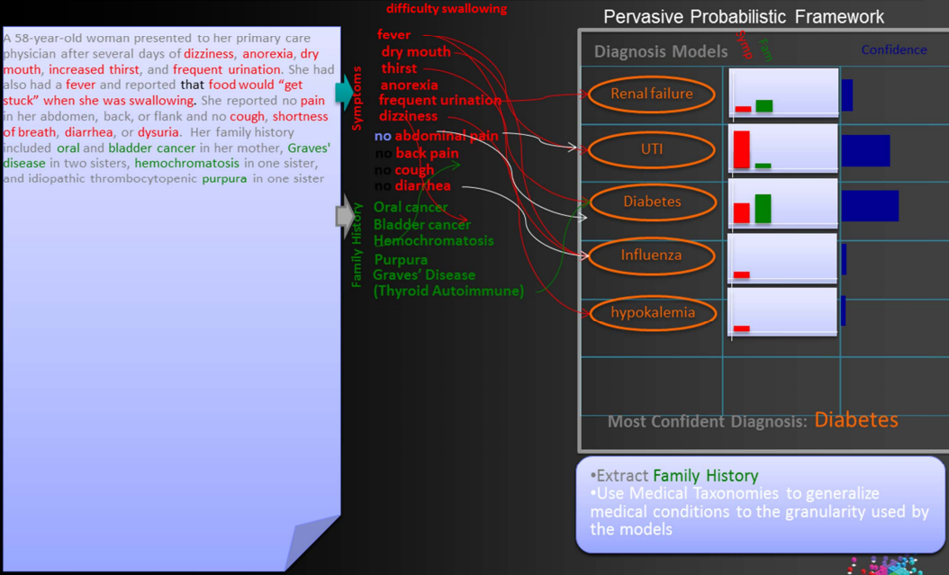
AI powered artificial Doctor: the dream…

Slide 18
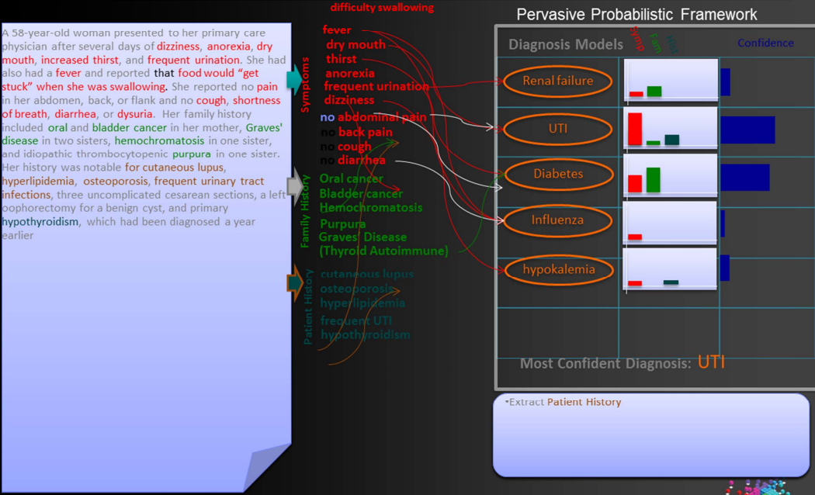
AI powered artificial Doctor: the dream…

Slide 19
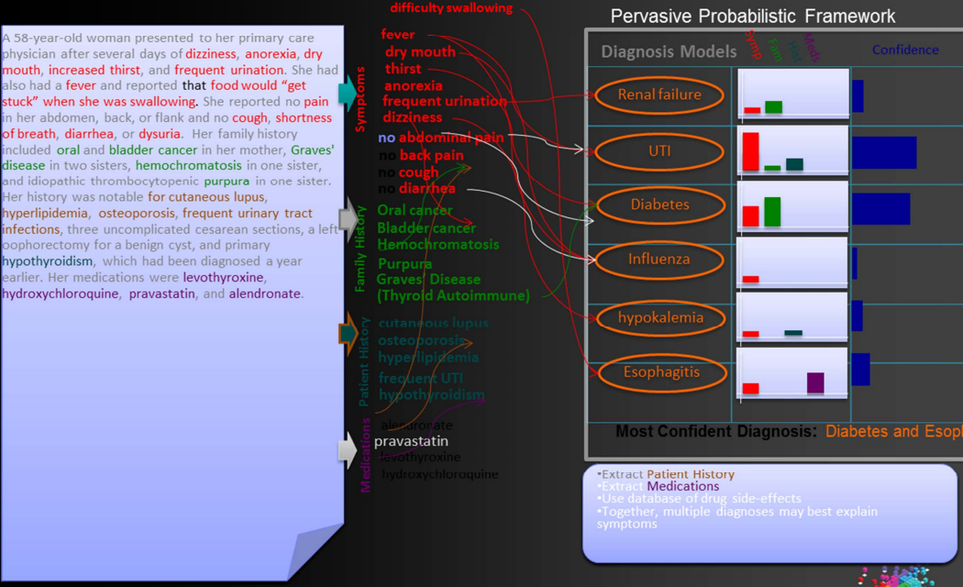
AI powered artificial Doctor: the dream…

Slide 20
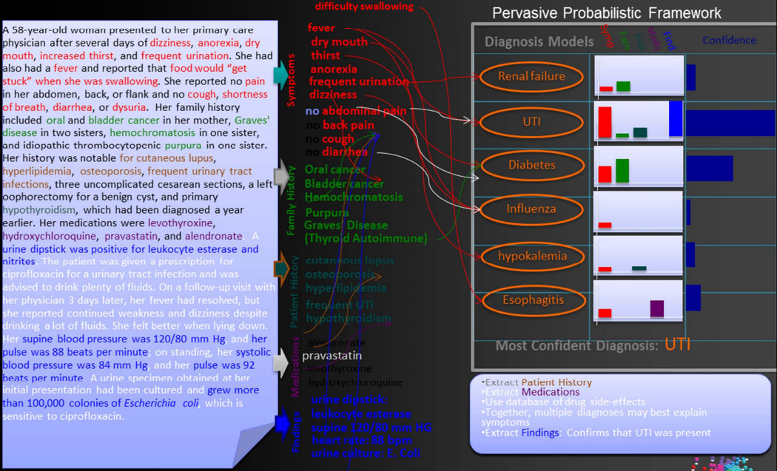
AI powered artificial Doctor: the dream…

Slide 21
Watson services
Watson services allow you to use remote machine intelligence services through convenient RESTful APIs
Image analysis
Speech transcription
Sentiment analysis
Language translation
Entity recognition
Video annotation
During the practical, you will use a Python library wrapper around said APIs

Slide 22
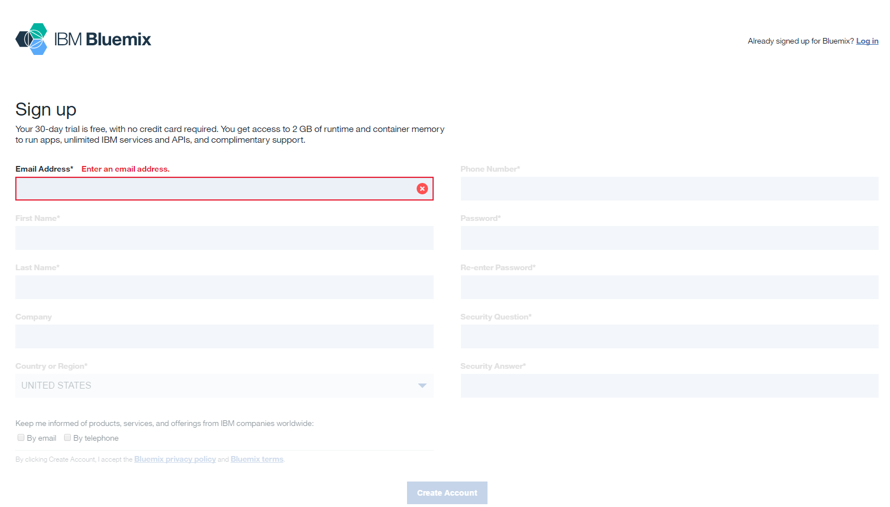
Practical
Create IBM Bluemix account at: https://ace.ng.bluemix.net/

Slide 23
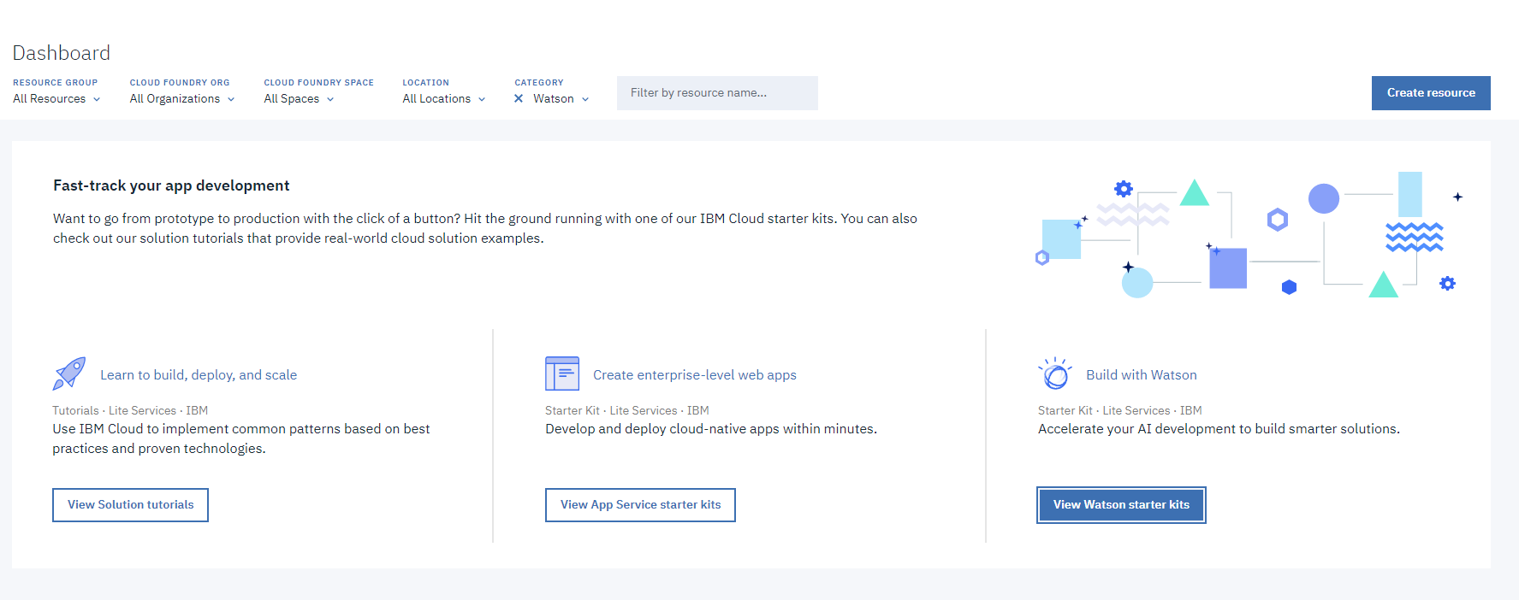
Practical

Slide 24
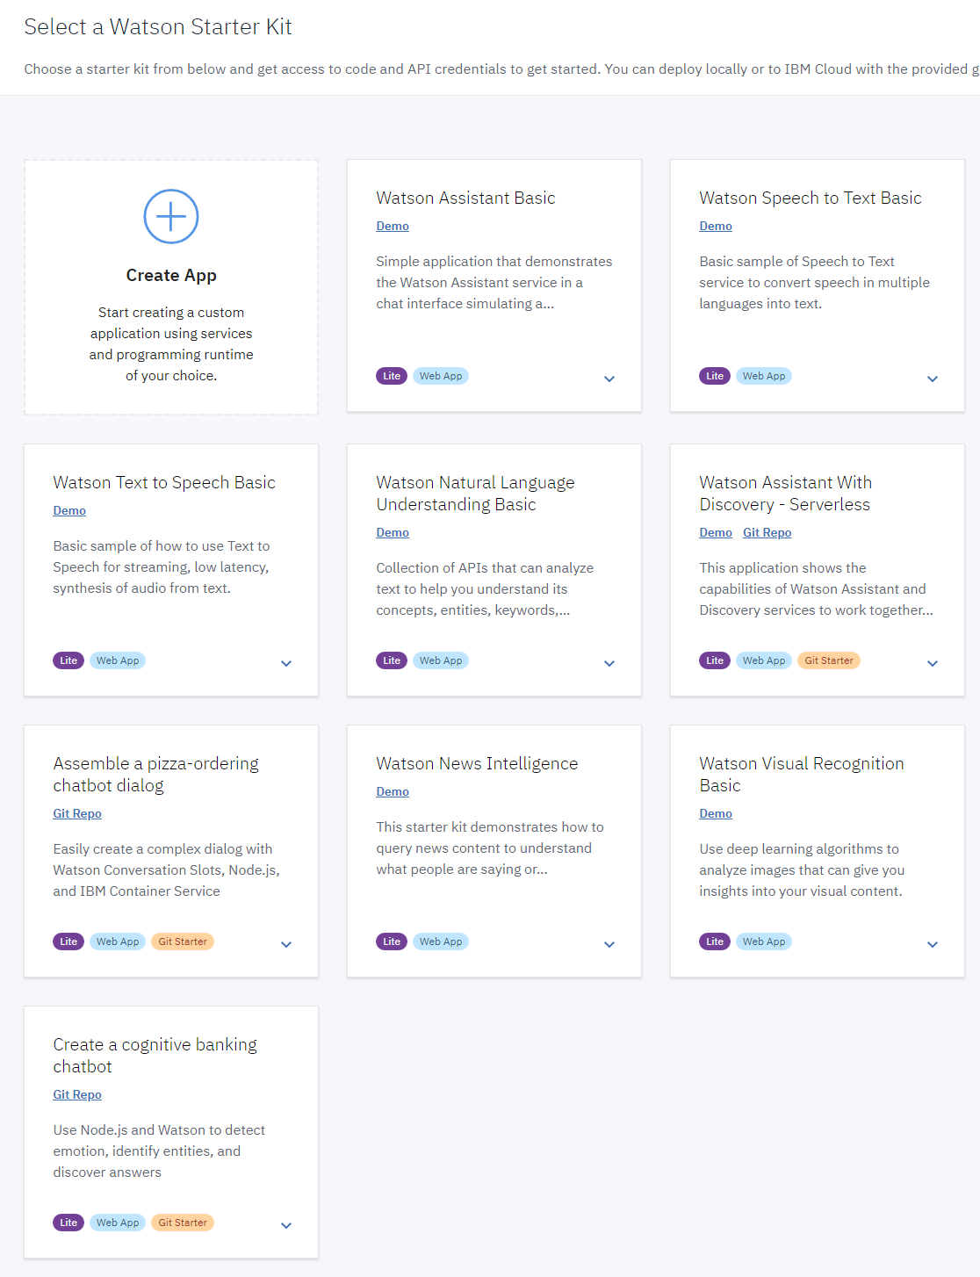
WATSON Services
Use the lite versions of the APIs!

Slide 25
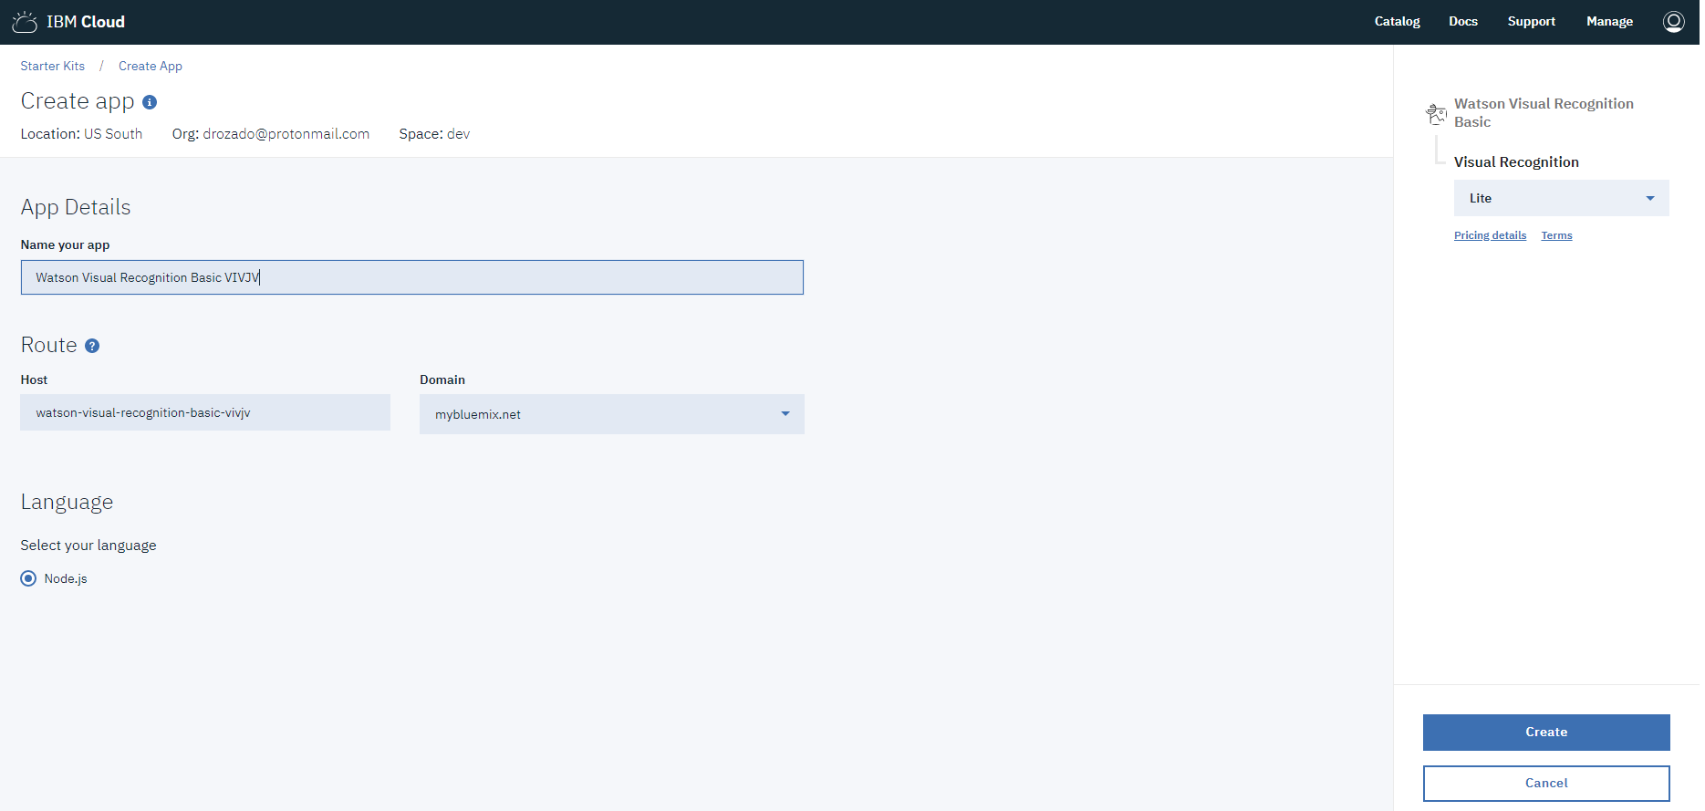
Create a cloud AI App

Slide 26
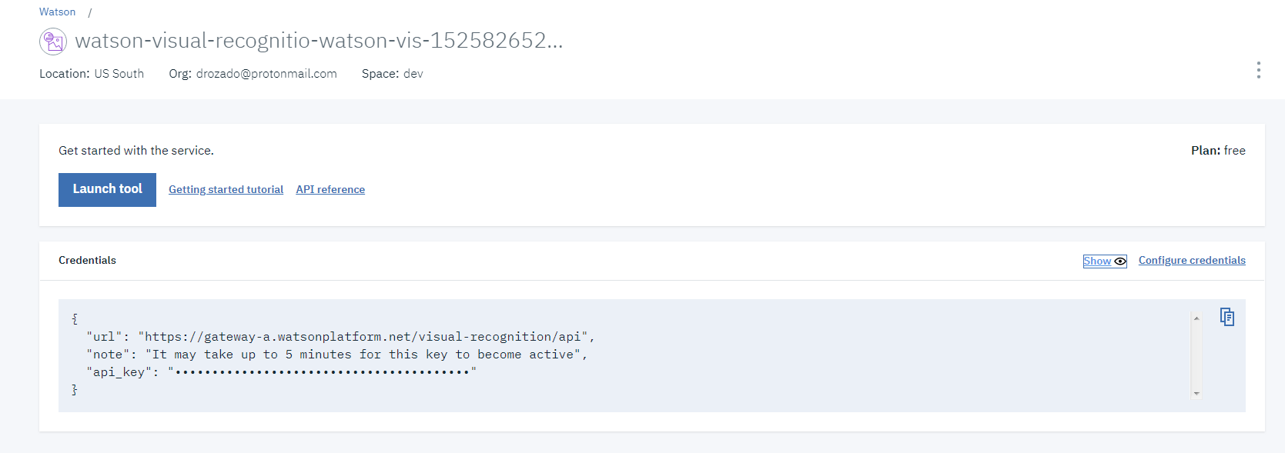
View credentials for Watson visual recognition service

Slide 27
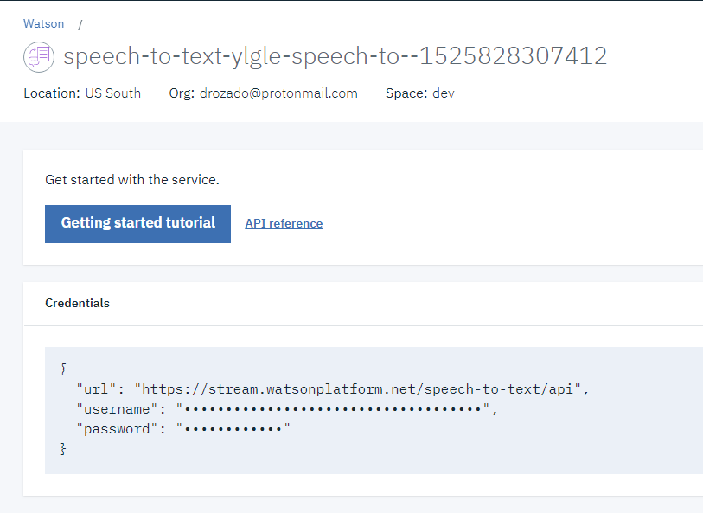
Some services require username and password instead of API key

Slide 28
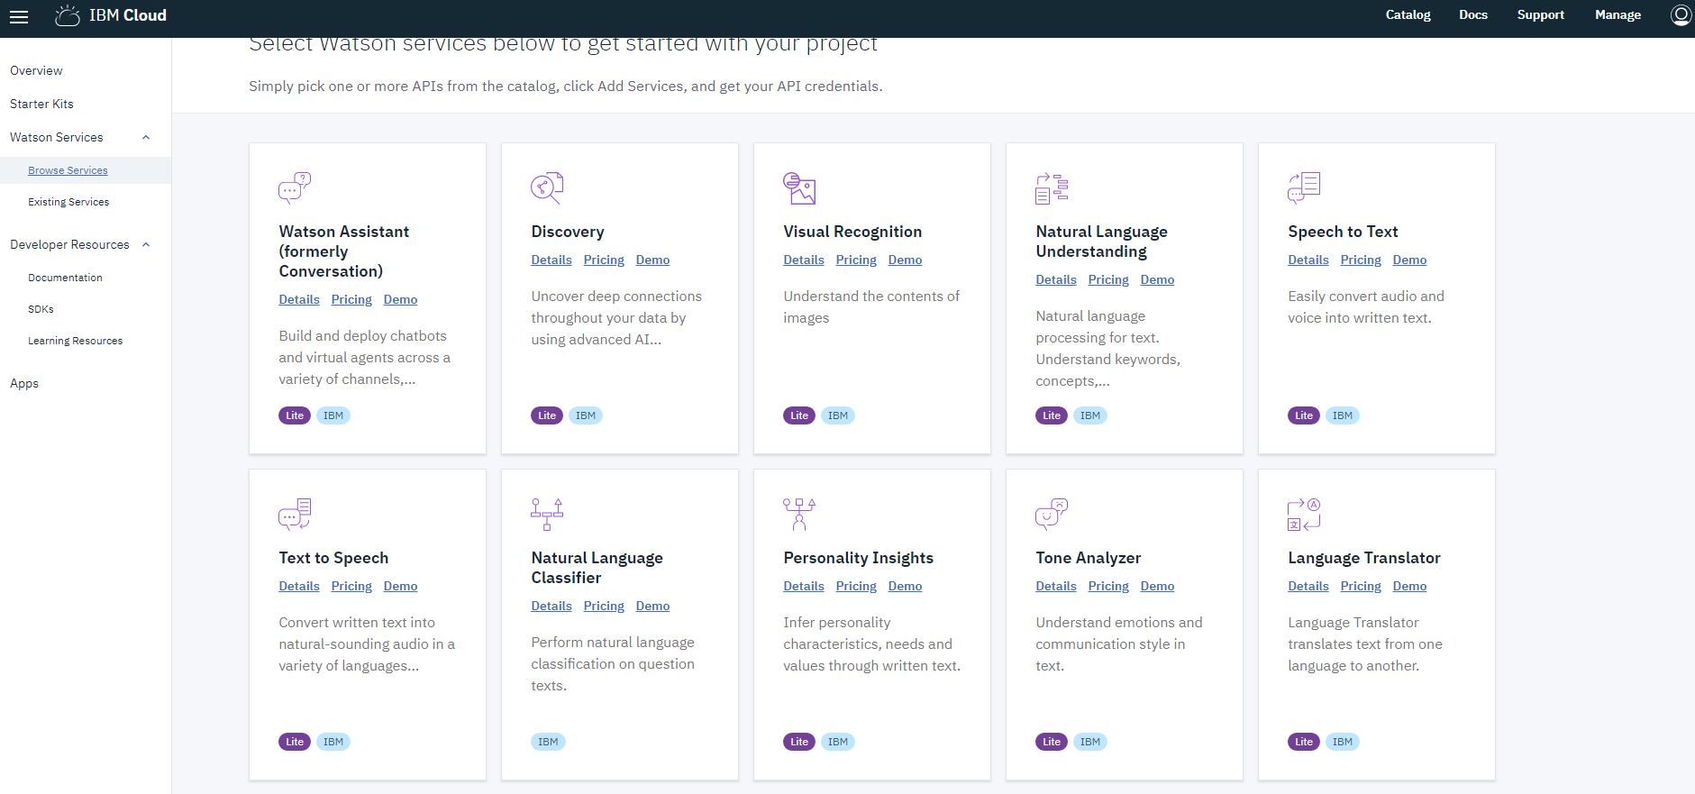
WATSON Services

Slide 29
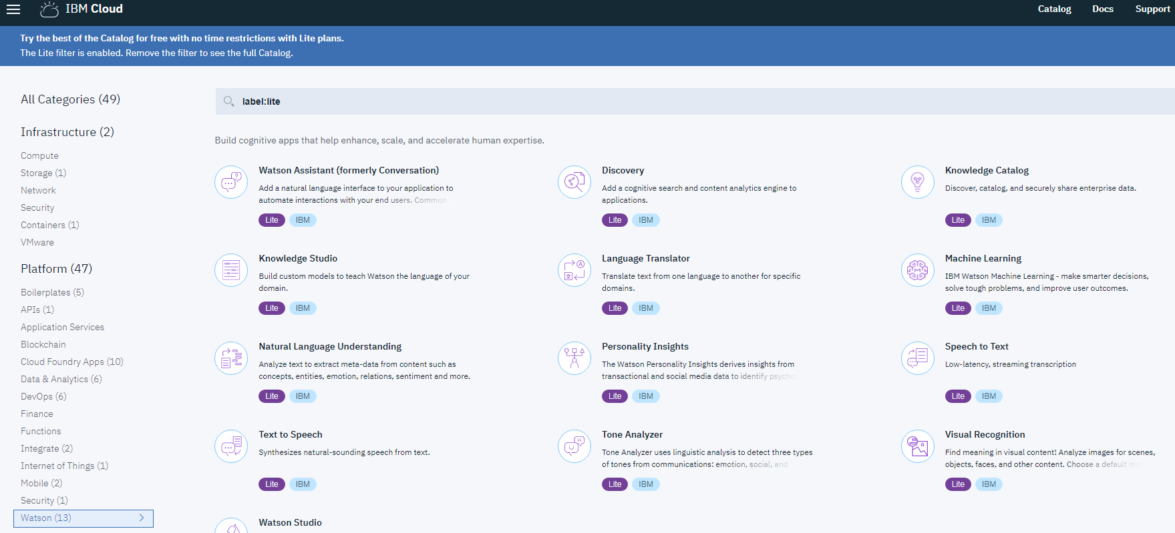
Don’t be overwhelmed by the multitude of options in the dashboards

